Slide 1


Slide 2



CONCEPTS
What is brainwriting?
Notes:
Brainwriting is an alternative method to brainstorming. It is a technique for rapid idea generation that eliminates many of the pitfalls of traditional brainstorming meetings.

Slide 3
CONCEPTS
There are a few different ways to approach brainwriting, but the basic method is as follows:
Each person writes down their ideas in response to a question or problem.
When finished, they pass their paper to the next person who then reviews the ideas and adds to them.
Once the papers have made a full round, the team shares all the ideas (usually on a whiteboard).

Slide 4
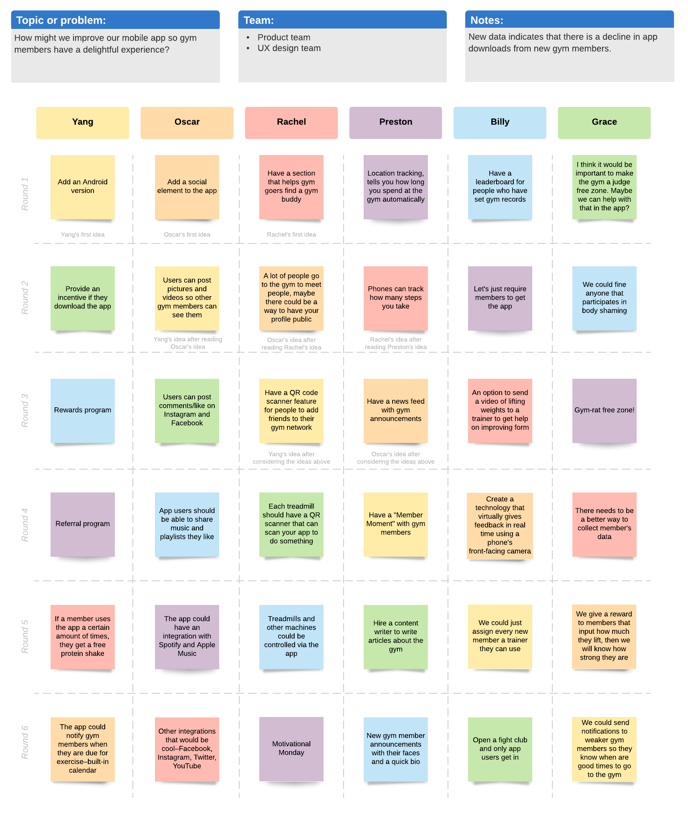
CONCEPTS
Brainwriting vs. brainstorming
Notes:
Typically during the brainwriting process, there is no conversation. Everyone is quiet and focused on committing their ideas to paper. Only after all the ideas have been recorded does the team begin sharing and discussing the group’s responses.
This is unlike brainstorming, where the group bounces ideas off one another out loud in no particular order.
Both techniques help teams generate ideas quickly, but brainwriting has some advantages over traditional brainstorming sessions.

Slide 5
CONCEPTS
Benefits of brainwriting
Brainwriting has several benefits and advantages over brainstorming.
Faster, more efficient idea generation
Less social anxiety and competing personalities
Often yields more diverse and creative ideas
Avoids falling into group-think consensus
Notes:
Because brainwriting has everyone write down their ideas at the same time, the process often generates more ideas faster.
Additionally, brainwriting is a more inclusive approach to idea generation because it gives everyone an equal opportunity to participate and share their thoughts.
In a traditional brainstorming session, it is easy for dominant personalities to, well, dominate the conversation. This can discourage more introverted team members from contributing. With brainwriting, that pressure to speak up is relieved and there is less focus on any one individual’s ideas.
Brainwriting also helps increase creativity and reduce anxiety because people can submit their ideas anonymously. Because no one’s name is attached to the ideas, people tend to be less self-conscious about sharing off-the-wall solutions. Plus, when no one has to vie for the spotlight, there’s less social anxiety over looking foolish in front of their peers or boss.
Finally, the brainstorming technique sometimes limits the variety and quality of ideas because the first ideas often become the focus of the discussion. It can prevent team members from adding new ideas because the group has already come to a consensus. Brainwriting ensures all ideas are shared and considered before the team begins honing in on any one solution.

Slide 6
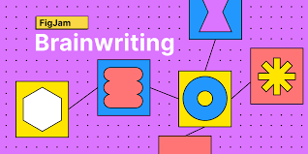
CONCEPTS
When to use brainwriting
Notes:
Brainwriting is a great alternative to brainstorming, especially when you have a mixed group of personality types (i.e., introverts and extroverts) or those who think better on paper first.
It’s also a good choice if you don’t have an experienced moderator to keep a lively brainstorming session on track. With brainwriting, most of the work is done quickly and quietly on paper, so it’s easier to stay focused on the question or problem at hand.

Slide 7

CONCEPTS
How to use brainwriting
Notes:
As noted earlier, the brainwriting technique is pretty simple. Everyone writes down their ideas and shares them (sometimes passing the papers around for the team to build on).
To ensure your brainwriting session is a success, follow these steps:

Slide 8

CONCEPTS
1. Clarify the rules and parameters
Notes:
Explain to the team what technique or process you will be following. Are there specific rules or parameters they should adhere to when generating ideas? For example, you might limit the number of ideas to 5 per person or allow only certain types of answers.

Slide 9
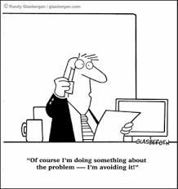
CONCEPTS
2. Identify the problem or question to be answered
Notes:
Next, identify what problem you are trying to solve or what question you want the team to answer. This is the prompt for the brainwriting process.

Slide 10

CONCEPTS
3. Have participants write down their ideas in a set amount of time
Notes:
As the brainwriting leader, you will keep time. Most brainwriting sessions are short and sweet. If you are having team members pass their cards to the next person for another round, shorter time limits work best (e.g., 3-5 minutes per round).

Slide 11

CONCEPTS
4. Share all the answers in one place
Notes:
Once the ideas are recorded, share them in one place. If you are all together in one room, writing the ideas on a whiteboard or taping the notes to the wall is an easy way to present everyone’s ideas.
You can also use a collaborative tool like Lucidchart to record ideas in a shared virtual whiteboard. An online whiteboard works especially well for remote or distributed teams who need to collaborate and stay on the same page. It’s also great for in-house teams where people can add ideas or notes anytime even after the official brainwriting meeting has ended.

Slide 12
CONCEPTS
Brainwriting techniques
There is more than one way to approach brainwriting. Other common brainwriting variations include:
6-3-5 brainwriting
Collaborative brainwriting
Remote brainwriting

Slide 13
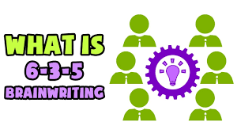
CONCEPTS
6-3-5 brainwriting
Notes:
This is a straightforward variation of a basic brainwriting session where you have a group of six people write down three ideas in five minutes on a worksheet. When the five minutes is up, each person passes their sheet to the next person to add another three ideas, and so on.
This process lasts for six rounds (until the worksheet is filled up and each person has their original paper back—filled with ideas). By the end of the process, you should have 108 ideas written down and ready to review.
The 6-3-5 method is a good option if you have a large group of people you want to get ideas from. Simply break the team up into groups of six and off you go. It makes the idea generation (and sharing) process much simpler among a lot of people.

Slide 14
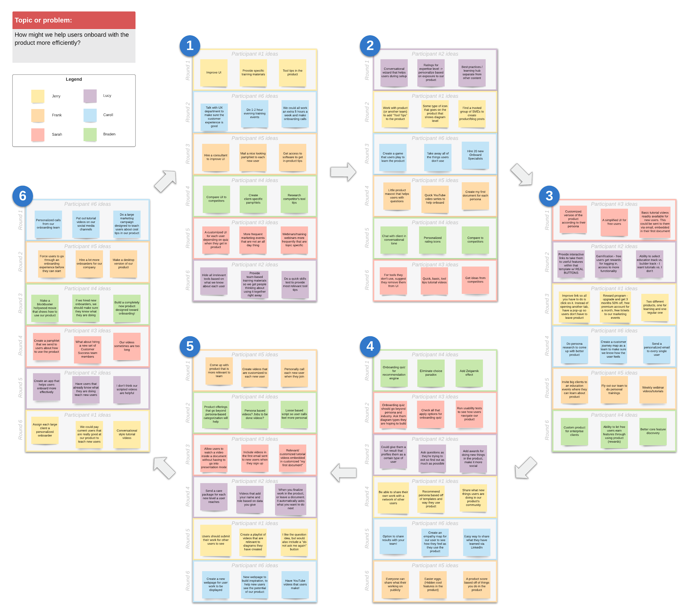
CONCEPTS
Collaborative brainwriting
Notes:
If you want to avoid a formal meeting, collaborative brainwriting is a good alternative. In this process, you select a space (a wall or whiteboard for example) that is easily accessible by your team and post a prompt.
Then, throughout the day or week (whatever timeframe you choose), your team can add ideas to the board as inspiration or convenience strikes.
This method is more flexible and low-key, which can work better for those who prefer to think through problems in their own time without the pressure of other people or the clock.

Slide 15
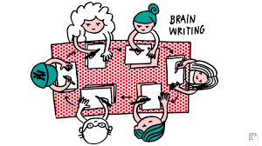
CONCEPTS
Remote brainwriting
Notes:
Similar to collaborative brainwriting, remote brainwriting provides a simple method for remote teams to generate and share ideas effectively.
Typically, the process follows the collaborative method where a question or problem is posed and the team can respond within a certain timeframe. The difference here is that the platform for sharing ideas is virtual.

Slide 16
CONCEPTS
Common remote brainwriting tools or platforms include:
Instant messenger
Email
Blogs or wikis
Google spreadsheets
Virtual whiteboards
Notes:
If you decide to use remote brainwriting, consider doing a test run first to work out any technical difficulties and determine the guidelines and best practices that will work best for your team.
Brainwriting is a simple and effective technique for generating many high-quality ideas in a relatively short amount of time. Combined with a team-building brainstorming session, and you will be well on your way to your next great ideas.

Slide 17
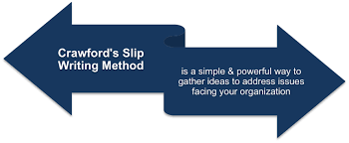
CONCEPTS
How to use the Crawford Slip Writing Method?
Notes:
As the Crawford Slip Writing Method uses speed to encourage creativity, it is normally used by large groups where time is short but has to be of high productivity. This allows people to express themselves without having to discuss their ideas in a monotonous and lengthy way.
It is also used to connect the ideas of large audiences, where time is also limited but which makes people feel that they are participating and expressing their opinions and ideas

Slide 18
CONCEPTS
Hand out the sheets of paper to each team member. Hand out the number of sheets according to the number of ideas you want to collect. These can be pieces of paper or Post-It notes.
Ask the group for ideas on the topic being addressed. Be specific or general, depending on what you need or are looking for in the answers.
Approach the topic with questions and challenges to allow for creativity from team members, e.g. How could we… in what way…?
The leader or facilitator can show images or say words that encourage the team’s creative responses.
Collect the answers after a certain amount of time, and then collect them according to the different sections you have with the working group.
Mix the ideas that are similar
Notes:
To keep participants focused on the task, one can set a time limit from the beginning. For example, if you are going to address three specific questions, you can set aside 10 minutes to work on the first question, 10 minutes for the second question, and 10 minutes for the last question. Of course, the amount of time you allocate to each question will depend on the complexity of the topic and the number of ideas you want to receive.

Slide 19
CONCEPTS
Recommendations for participants using the Crawford Slip Writing Method
Write down the ideas, be specific in your writing
Write one idea per card.
Be specific in what you want to express
Describe the idea in a few words

Slide 20
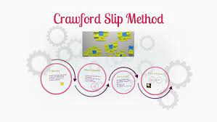
CONCEPTS
Feedback in the Crawford Slip Writing Method?
Notes:
After collecting each person’s answers, it is important to make an analysis in order to draw conclusions that help to deepen what you want to achieve with the team, whether it is the solution to a problem or the decision making necessary to meet objectives.
This is why feedback plays an important role in the success of the working session. In this way, you can get an idea of how to improve the problem or issue you are dealing with. Also the team members will know what they think about their ideas and how these provide important data for success.
With this Crawford writing method, the aim is to collect information from each team member in a very short time but which can result in qualitative data of ideas. If this tool is used in a correct way it can be of great help for problem solving, analysis of negative points of the company, creative ideas to solve bottleneck situations, among others.
Thus, quality decisions can be made to improve the company’s productivity.
Keep in mind when putting this method into practice:
This method, when used in most cases in large groups, should be taken into account that people might feel embarrassed, angry or cautious when asked to participate in the brainstorming since it is not always easy to express thoughts, opinions and ideas in front of others. But by creating a space of trust, energy and motivation in front of the group, people will be able to share what they want.
This method can also be used anonymously.

Slide 21
CONCEPTS
Advantages
The cost of this method is inexpensive as it only requires paper cups, pens, a facilitator and participants.
Time is short, which makes it a tool that fits the speed of idea creation.
It can be used in team co-creation space or in work projects that need inspiration to address issues.
This method helps the more shy or silent people in the team to participate in the brainstorming discussions.
The more people in the group, the more ideas you get.
Creativity can emerge in a more practical way when written down on paper, this helps people reflect their ideas and thoughts more clearly.

Slide 22
CONCEPTS
Disadvantages
Must be a method used in a face-to-face way, since in a virtual way it could not have the same results.
The members of the activity cannot take the ideas of their colleagues and develop them separately.
If the participation of each member of the team is not organized, it could generate a lack of control since it is a method normally used with large teams.
If team members are not motivated, you may see a lack of synchronisation and you may not achieve the goal of creativity that you are looking for among the collection of ideas.

Slide 23

CONCEPTS
Simple but powerful method for companies
Notes:
Crawford’s Slip Writing Method is a simple tool that can be used in companies at times when they need to be highly creative and effective either for problem solving or for the creation of new lines, improvements or new challenges that the organization is going through.
With just paper, pencil and motivation, great ideas can be achieved that will emerge from each individual. This gives the opportunity for each person to express their ideas and have them shared and heard and why not link many of them to achieve the solutions they need to obtain for the topic being discussed at the meeting.
This type of space and method will make the potential of the company grow and those involved feel that they are participating in it for progress and organizational development.
The preparation of the meeting with the team must be prepared in advance as the right questions to be addressed in the meeting are important for the flow of connection that each member will have with creativity and ideas, in this space of co-creation.
At the beginning of the meeting, you should highlight in detail the problems or issues to be addressed. Depending on the complexity of the topic, a presentation is needed to bring the team up to speed and to get everyone in the same frame of mind.

Slide 24
CONCEPTS
Examples of specific business questions could include:
What new products should we launch to the public to expand our line?
Are there any products that are in high demand that we do not yet have?
How can we improve our efficiency in the production processes?
What improvements in delivery to the end customer could be made?
Notes:
These types of questions and those you feel are necessary for your organisation should be asked as a team-building impulse.
Creativity is valued and is an initiative that can be taken when using this method. Companies need creativity to move forward and this is an important tool to achieve this. Employees like this format because it is quick and agile and the meeting is short and precise.

Slide 25







/ethnuscodemithra
Ethnus Codemithra
/ethnus
/code_mithra
THANK YOU
https://learn.codemithra.com/
codemithra@ethnus.com
+91 7815 095 095
+91 9019 921 340

Slide 26
CONCEPTS

Slide 27
CONCEPTS

Slide 28
CONCEPTS

Slide 29
CONCEPTS

Slide 30
CONCEPTS

Slide 31
CONCEPTS

Slide 32
CONCEPTS

Slide 33
CONCEPTS

Slide 34
CONCEPTS

Slide 35
CONCEPTS

Slide 36
CONCEPTS

